Slide 1
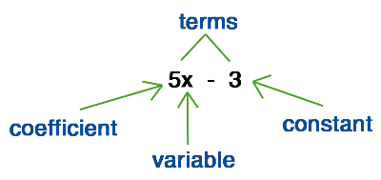
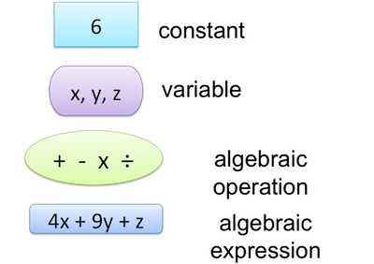
My Algebra Interactive Notebook
Name
Class
Teacher Mr Evans
Term 2 Semester 1
1

Slide 2
Contents
Glossary or Formula Page
Page
Date
Description
2
3

Slide 3
Tasks
24
7
30
Essential Question
Questions
Notes
Summary

Slide 4

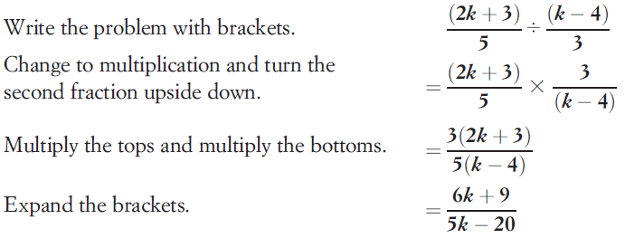
24
7
30
Date
Dividing Algebraic Fractions
EQ – What is the difference between dividing algebraic fractions and normal fractions?
What do I need to do when dividing fractions?
When dividing fractions, we multiply by its reciprocal. We do likewise when dividing algebraic fractions.
Example

Slide 5
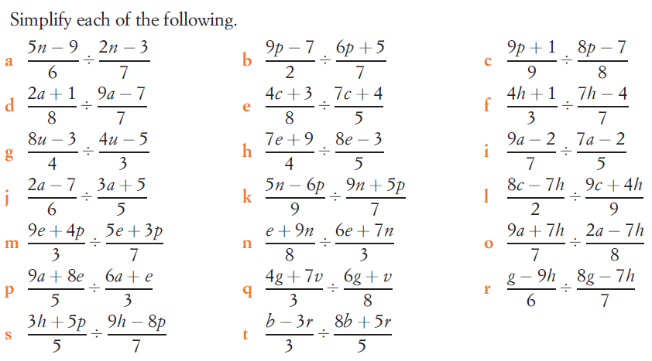
Task

Slide 6
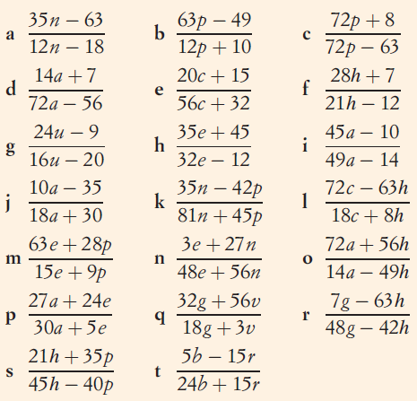
Answers

Slide 7
Notes Review
24, 7 ,30
Date
Title
Essential question
Notes complete
Notes complete with colour and diagrams
Questions completed
Contents page filed in
Formula page filled in

Slide 8
Homework
Review your notes and write a summary answering the essential question.

